Slide 1

Academic-Related and Professional Staff Surveys

Slide 2
Two surveys
One for all ARPS staff – Launched in in November 2019.
Second survey of branches – 16 branches responded to the survey. Response to three motions:
HE21 on Investigating the effect of hubs and 'service' centralisation
Supporting student counselling services
Damaging changes to IT services
Notes:
HE21 to Congress 2018 and to last year’s annual meeting.
Supporting student counselling services and Damaging changes to IT services - both motions came to the 2019 annual meeting.

Slide 3

Overview of staff survey
Over 2300 responses (>2000 complete)
121 different institutions
~55% Russell Group, ~35% other Pre-92, 11% Post-92
HESA: 45% Russell Group, 25% other Pre-92, 30% Post-92

Slide 4
Areas of work- summary

Slide 5

Areas of work- detail
Area of work | Count of Responses
IT | 392
Information services, libraries & archives | 272
Departmental, faculty or school administration | 239
Other - please specify | 206
Research support | 195
Educational, academic and curriculum development | 142
Governance including academic registry, compliance and legal | 76
E-learning and educational tech | 72
Student services (including student union, mental health & counselling services) | 59
Careers & employability | 56
Student recruitment & admissions | 50
Student learning support (including learning technology, disability support & language services) | 44
Project Management | 38
Technician | 34
International partnerships | 27
Human Resources and personnel (including health & safety) | 27
Public affairs & outreach (including alumni and fundraising) | 24
Estates and planning | 22
Widening participation | 17
Museum, galleries & culture | 16

Slide 6
Areas of work- other
Work areas in “Other” with multiple responses:
Area of work- Other | Count of responses
Finance | 30
Comms/Marketing | 25
Public/community engagement | 7
Impact/evaluation | 5
Business development | 4
Clinical trials | 4
Notes:
We’ll add Finance & Comms/Marketing as options in future surveys

Slide 7
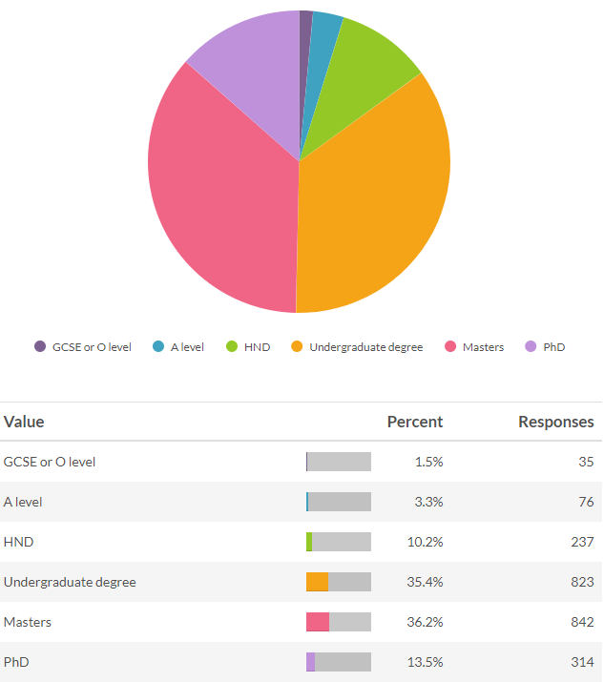
Qualifications
50% of respondents have a post-graduate qualification

Slide 8
Qualifications
Highest qualification by area of work:
Area of work | up to A levels/Diploma | Undergraduate degree | Postgrad
Educational, academic and curriculum development | 4% | 17% | 79%
Careers & employability | 7% | 25% | 68%
Information services, libraries & archives | 3% | 31% | 66%
Research support | 7% | 29% | 64%
E-learning and educational tech | 14% | 28% | 58%
Departmental, faculty or school administration | 21% | 36% | 42%
Governance including academic registry, compliance and legal | 9% | 49% | 42%
Student services (including student union, mental health & counselling services) | 10% | 52% | 38%
Student recruitment & admissions | 12% | 52% | 36%
IT | 25% | 45% | 30%

Slide 9
Contract type
8.4% of respondents were on a fixed term contract, ~1% on ZHC/hourly paid/variable hours
Fixed term contracts disproportionately affect those working in:
  Research Support 26% on fixed term contracts
  Project Management 52% on fixed term contracts

Slide 10
Pay
Two clusters at point 36/37 & 43/44
Chart is dominated by IT & Information services, but similar pattern across all areas of work

Slide 11
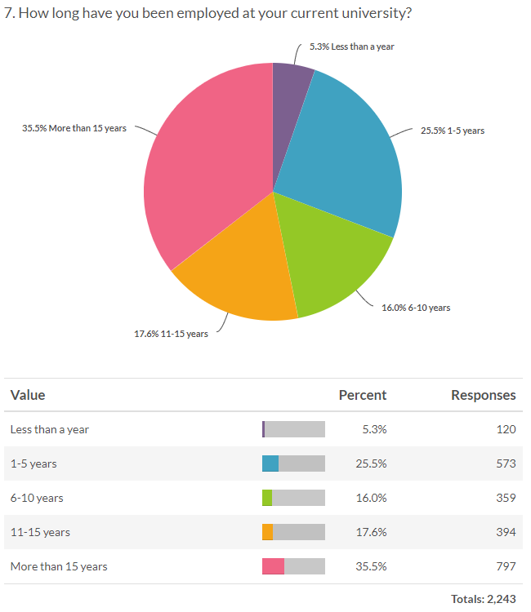
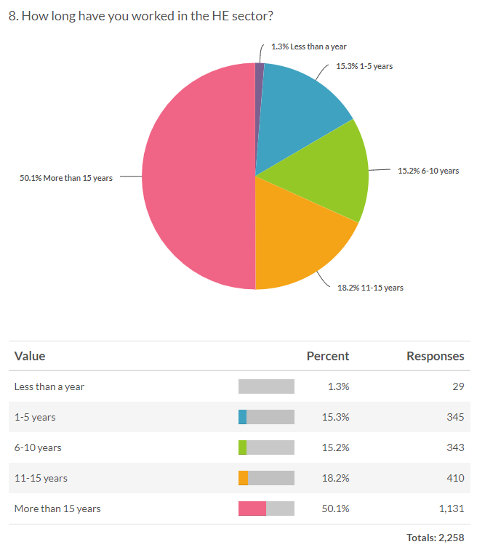
Length of employment
Notes:
Understanding our membership- are we reaching a big enough pool? New to sector people.
Add something about non-members
Age?
-Length at current uni by role

Slide 12
Length of employment
Length of employment at current institution by area of work
Area of work | Less than a year | 1-5 years | 6-10 years | 11-15 years | More than 15 years | Grand Total
IT | 1% | 20% | 10% | 16% | 53% | 390
Departmental, faculty or school administration | 5% | 20% | 16% | 18% | 40% | 238
Information services, libraries & archives | 6% | 23% | 12% | 20% | 40% | 269
Governance including academic registry, compliance and legal | 9% | 16% | 26% | 17% | 32% | 76
Careers & employability | 4% | 31% | 16% | 18% | 31% | 55
Student recruitment & admissions | 10% | 30% | 10% | 20% | 30% | 50
Student services (including student union, mental health & counselling services) | 4% | 26% | 26% | 18% | 26% | 57
E-learning and educational tech | 4% | 21% | 25% | 28% | 22% | 72
Educational, academic and curriculum development | 11% | 38% | 15% | 15% | 22% | 141
Research support | 11% | 38% | 18% | 11% | 21% | 193
Notes:
Understanding our membership- are we reaching a big enough pool? New to sector people.
Add something about non-members
Age?
-Length at current uni by role

Slide 13
Promotions
44% of respondents have been promoted at their current institution
17.5% have clear promotional pathways available
22% feel they are encouraged to apply for promotions
Notes:
“Stuckness”- clustering, length of employment, promotions

Slide 14
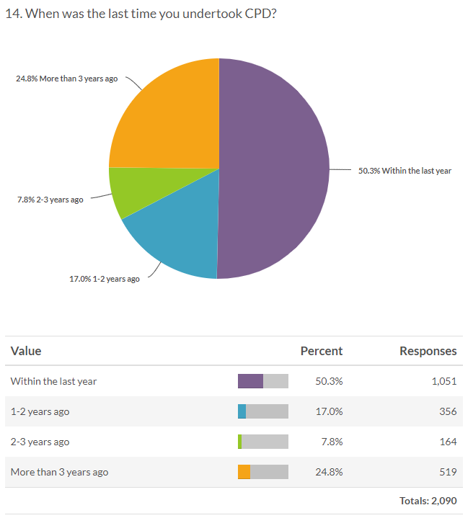
CPD
26% have defined CPD as part of job

Slide 15
CPD
% with defined CPD as part of job by area of work:
Area of work | Yes | No | Responses
Information services, libraries & archives | 43% | 57% | 272
Student learning support (including learning technology, disability support & language services) | 41% | 59% | 44
Human Resources and personnel (including health & safety) | 41% | 56% | 27
Careers & employability | 39% | 61% | 56
E-learning and educational tech | 36% | 63% | 72
Student services (including student union, mental health & counselling services) | 31% | 69% | 59
Technician | 29% | 71% | 34
Governance including academic registry, compliance and legal | 25% | 75% | 76
Student recruitment & admissions | 24% | 76% | 50
Research support | 24% | 75% | 195
Other - please specify | 23% | 77% | 206
International partnerships | 22% | 78% | 27
Educational, academic and curriculum development | 22% | 76% | 142
IT | 20% | 79% | 392
Departmental, faculty or school administration | 17% | 82% | 239
Project Management | 11% | 89% | 38
Notes:
-By area of work

Slide 16
Professional bodies
36% are members of a professional body
Employers pay for membership for 38% of these
Professional body | Number of respondents who are members (>= 10 members) | Does employer pay for membership?
CILIP, Chartered Institute of Library and Information Professionals | 113 | 3
AUA, Association of University Administrators | 76 | 8
ARMA, Association of Research Managers and Administrators | 55 | 43
AGCAS, Association of Graduate Career Advisory Services | 46 | 43
BCS | 15 | 2
HELOA, Higher Education Liaison Officers Association | 12 | 11
SEDA, Staff and Educational Development Association | 10 | 0
AMOSSHE, Association of Managers of Student Services in HE | 10 | 9
BACP, the British Association of Counselling and Psychotherapy | 10 | 0
CIPD | 10 | 1
Notes:
Highlighted areas where employer tends to pays for membership

Slide 17
Community of Practice
40% respondents are members of a “Community of Practice” (a group of people who share a craft or profession who collaborate either through physical or virtual discussion groups)
Area of work | Yes | No | Grand Total
Careers & employability | 63% | 38% | 56
E-learning and educational tech | 60% | 38% | 72
Information services, libraries & archives | 54% | 46% | 272
Student learning support (including learning technology, disability support & language services) | 52% | 43% | 44
Human Resources and personnel (including health & safety) | 52% | 44% | 27
Student services (including student union, mental health & counselling services) | 46% | 54% | 59
Governance including academic registry, compliance and legal | 45% | 55% | 76
Educational, academic and curriculum development | 41% | 59% | 142
Other - please specify | 38% | 61% | 206
Project Management | 34% | 66% | 38
IT | 31% | 68% | 392
Research support | 31% | 69% | 195
Student recruitment & admissions | 28% | 72% | 50
Technician | 26% | 74% | 34
International partnerships | 26% | 74% | 27
Departmental, faculty or school administration | 19% | 80% | 239
Notes:
-By area of work

Slide 18
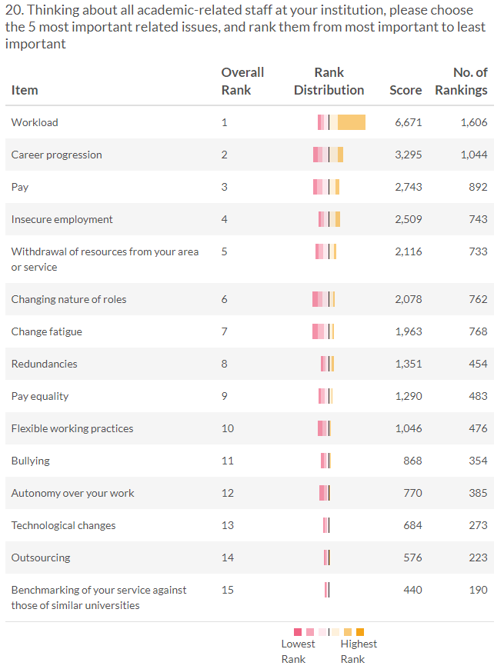
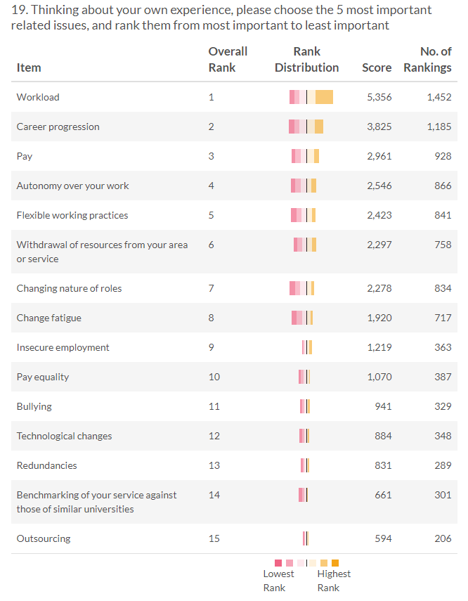
Most important issues
Notes:
-By area of work

Slide 19
Recruitment issues
33% reported their employer was struggling to recruit in their area of work (similar across all mission groups)
Pay rates was the biggest reason at post-92s, skills shortage was biggest recruitment issue at pre-92s
Reason | Responses
Pay rates | 254
Scarcity of appropriate skills | 231
Other | 116
Lack of career pathways | 45
Reason for recruitment struggle | Post 92 | Other pre-92 | Russell Group
Lack of career pathways | 13% | 8% | 8%
Pay rates | 58% | 44% | 48%
Scarcity of appropriate skills | 28% | 48% | 43%
Notes:
-By area of work and mission group

Slide 20
Academic freedom
62% believe their role requires academic freedom
Area of work | Yes- role requires academic freedom
Educational, academic and curriculum development | 87%
Information services, libraries & archives | 78%
E-learning and educational tech | 76%
Careers & employability | 75%
Research support | 65%
Other - please specify | 58%
Departmental, faculty or school administration | 55%
Governance including academic registry, compliance and legal | 53%
IT | 48%
Student services (including student union, mental health & counselling services) | 44%
Student recruitment & admissions | 32%

Slide 21
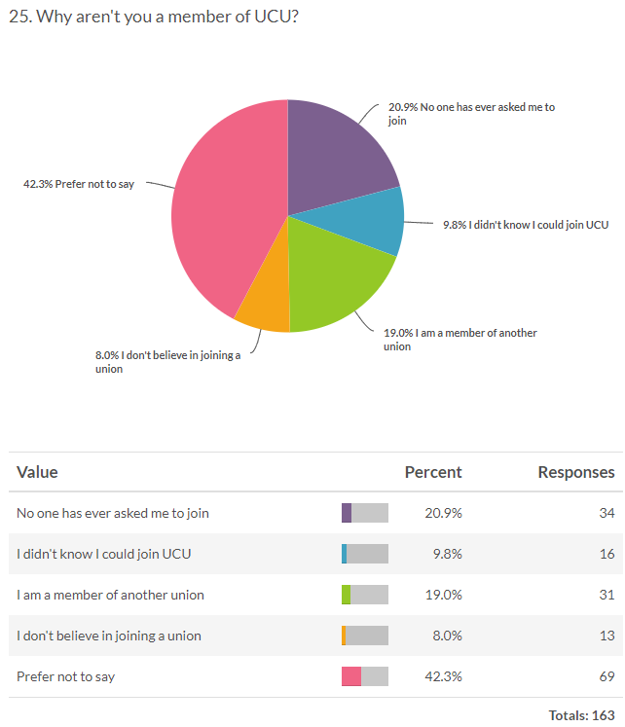
Union membership
92% of respondents are UCU members
Reasons for not being a member:

Slide 22

Survey of branches

Slide 23
Hubbing and centralisation of services
13 branches had hubbing, 3 didn’t.
Student support services (including counselling) were most likely to be centralised.
Other services affected includes student/departmental admin; IT; Research Support; Finance and HR.
1 branch said hubbing had improved the counselling service, but all others said it had ‘mixed results depending on service’ or a ‘detrimental impact’.
No hubbing had been reversed.
Notes:
1 branch commented that there were ‘no departmental staff any more’.
1 branch said hubbing had improved the counselling service – they had also had an increase in funding to this service.
All others said it had ‘mixed results depending on service’ – 8 branches - or a ‘detrimental impact’ – 4 branches.

Slide 24
Hubbing or centralising of services continued
Key themes of concern raised by branches:
Part of a cost-cutting drive.
Loss of local knowledge.
Loss of working relationships.
Loss of autonomy.
No safe space and effects confidentiality for staff and students.
Notes:
Is the info being transferred accurate? Are personnel files with erroneous info. being passed over? Individuals need to ask to see their files under GDPR

Slide 25
Counselling services
Changes to counselling services:
6 branches had seen cuts to funding.
5 branches had seen changes to staff contracts.
4 branches had seen a reduction in hours.
3 branches had seen an increase in funding.
4 branches had no change in funding.
Accessing services:
9 branches believed staff and students were struggling to access services.
4 branches didn’t know.
3 branches said staff and students could access services.

Slide 26
Counselling services continued
Key themes:
Long waiting lists.
Outsourcing of services, particularly for staff.
Mixture of contract types being used, but 3 branches only had staff on permanent/open-ended contracts.
Downgrading of roles.
UCU resources:
Most branches wanted materials highlighting the importance of the service.
A close second was campaign materials focused on increased funding and resources to the service.
Other requests included materials on challenging casualisation and equality of resources for students AND staff.
Notes:
4 branches talked about long waiting lists, and struggling to keep up with demand even with extra resources. But 1 branch had seen increased support for student mental health services.
External services were seen as poorer because they weren’t face-to-face.
Downgrading was seen to be impacting on recruitment and retention.

Slide 27
IT services
Changes to IT services:
9 branches had seen cuts to funding.
6 branches had seen changes to contracts.
8 branches had seen outsourcing or the use of contractors.
3 branches had seen no changes.
Opportunities for promotion and career progression:
3 branches said there were opportunities to a certain level.
5 branches said there were opportunities but only when managing others.
2 branches said there were no opportunities.
4 branches said this situation was impacting on retention and recruitment.
Notes:
Outsourcing – of the branches where outsourcing had happened or contractors brought in, 7 branches said they had the skills in-house to do this work.

Slide 28
IT services continued
Key themes of concern:
Repetitive restructuring.
Grade drift.
Outsourcing and use of contractors.
Lack of training and development.

