Slide 1
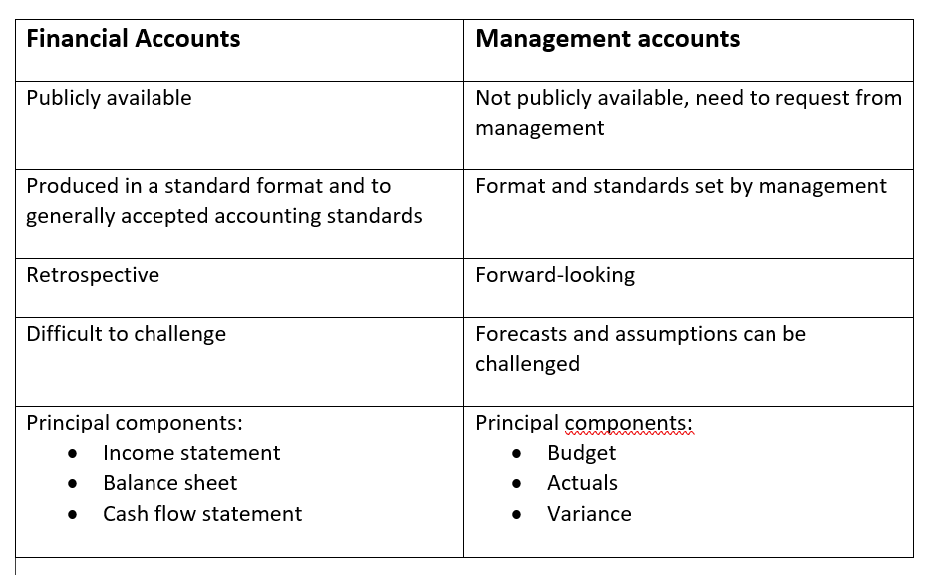

Slide 2
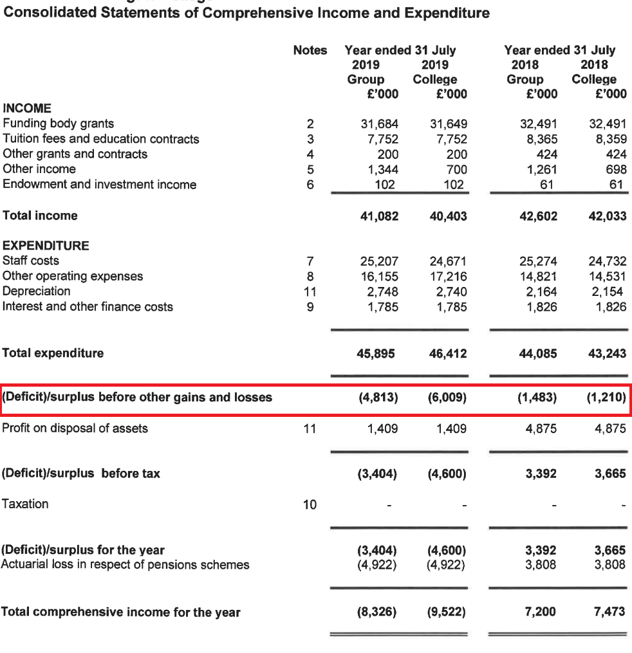

Slide 3
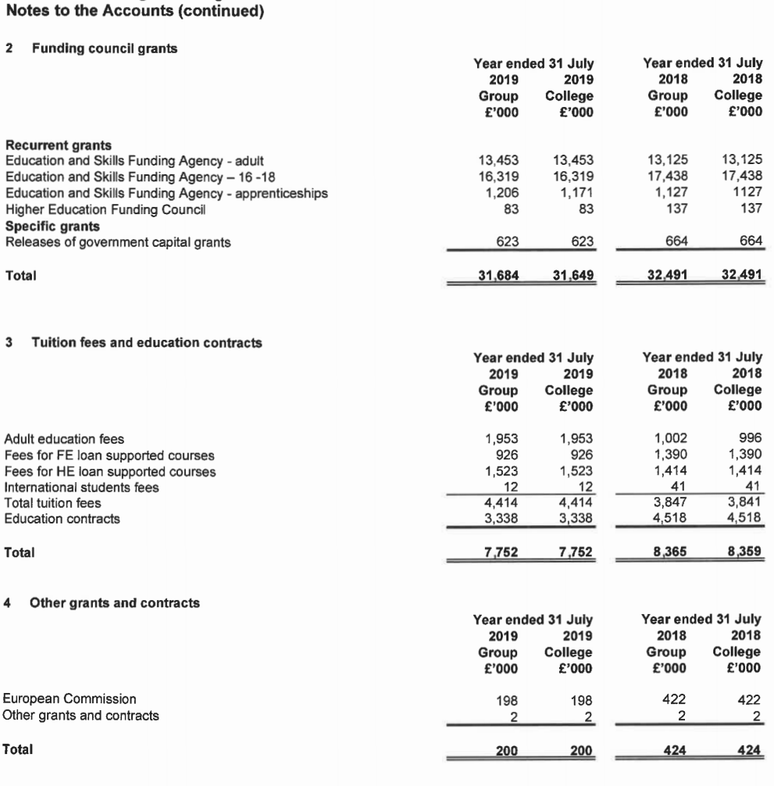

Slide 4
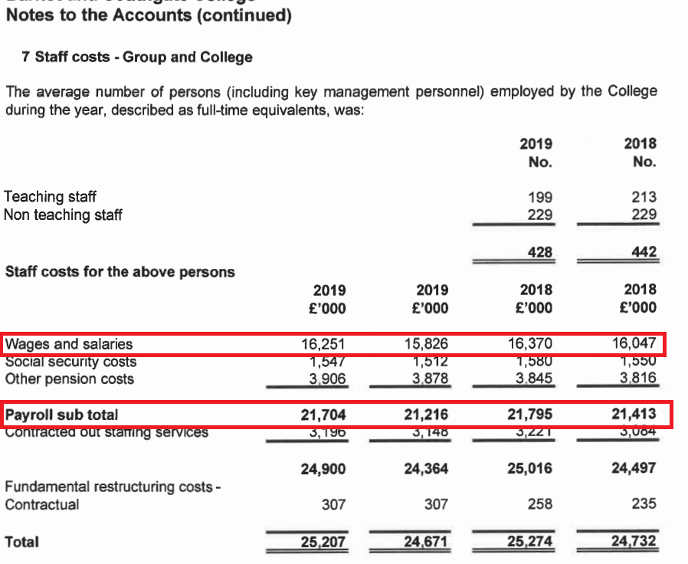

Slide 7
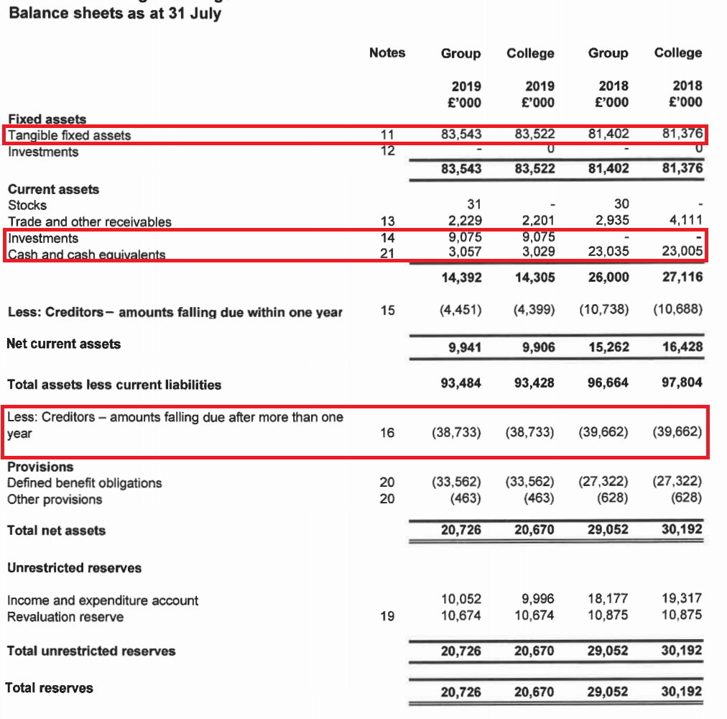

Slide 8
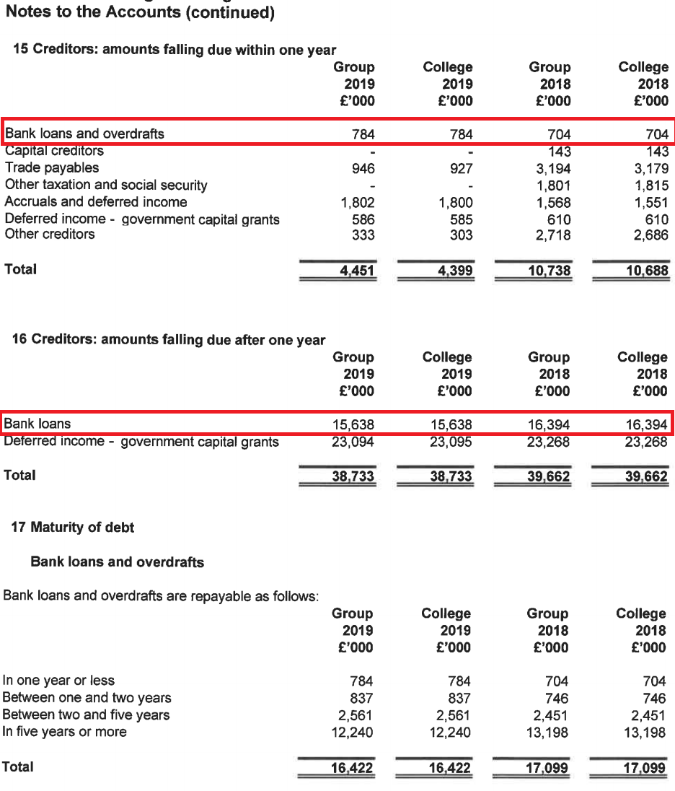

Slide 9
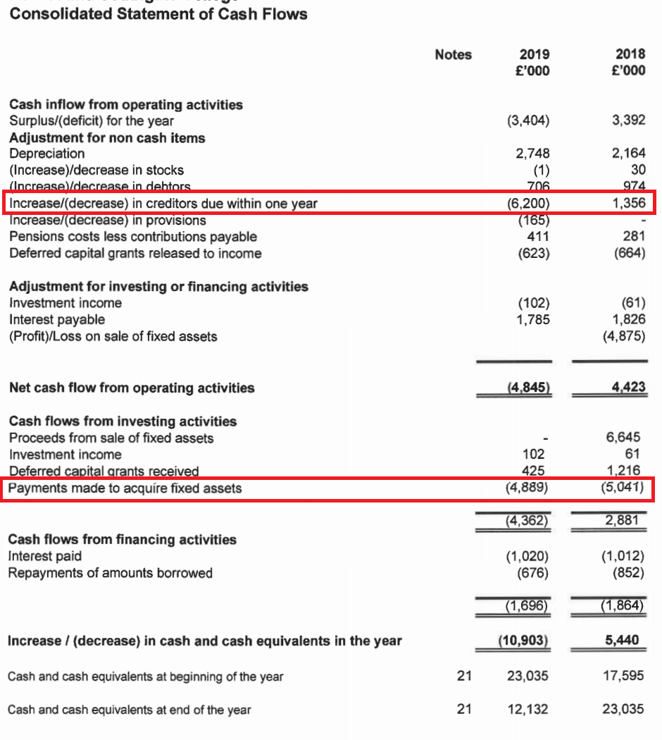

Slide 11
ESFA Financial Health
Solvency: Adjusted current ratio Current ratio = Current assets/current liabilities
Performance: Sector-specific EBITDA as a percentage of adjusted income EBITDA = Earnings before interest, taxes, depreciation and amortization Adjusted income excludes certain items including net return on LGPS pension scheme, Restructuring Facility grants and most capital grants.
Borrowing: Borrowing as a percentage of adjusted income Borrowing = bank loans, overdrafts, finance leases and repayable official support such as Emergency Funding

Slide 12
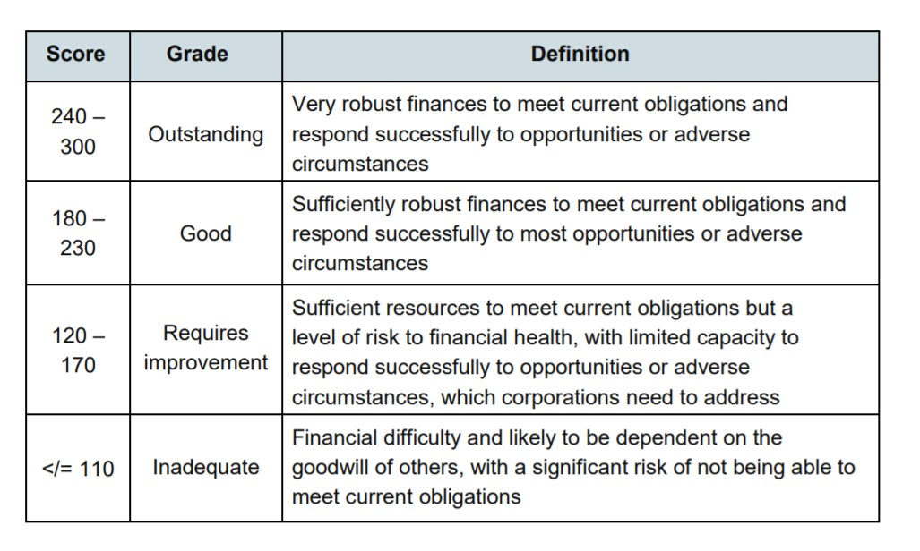

Slide 14
FINANCIAL ANALYSIS
Start by reviewing the published accounts, if necessary over several years
Focus on:
- income (trend) - expenditure (trend) - debt - cash
3. Review the management’s budget. What assumptions has management made about each of these four items, and how does it propose to achieve its targets?
4. Raise questions with management

Slide 15
QUESTIONS FOR MANAGEMENT
If there is a structural deficit: - How does management plan to eliminate it - What are the implications for headcount and pay - What alternatives were considered
If debt is high: - What are the terms of existing loans (debt covenants) - Can they be renegotiated - What are the costs and risks of refinancing debt - What are the options for reducing debt
If the college is running out of cash: - What is causing the cash drain - What are the options for stopping it
If the college has sold assets: - What was the money used for

