Slide 1









Slide 2

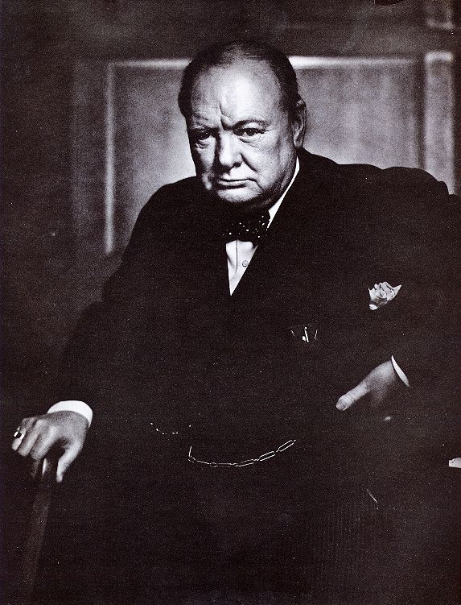
EUGENICIST THINKING
“The unnatural and increasingly rapid growth of the feebleminded classes, coupled with a steady restriction among all the thrifty, energetic and superior stocks constitutes a race danger. I feel that the source from which the stream of madness is fed should be cut off and sealed up before another year has passed.”
Winston Churchill MP, Home Secretary at the time the Mental Deficiency Act of 1913 became law.
In 1911 Churchill failed to get Sterilisation Bill through Parliament
1

Slide 3
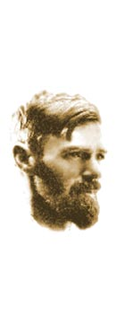
Eugenicist Thinking -2
D.H. Lawrence
“If I had my way, I would build a lethal chamber as big as the Crystal Palace, with a military band playing softly, and a cinematograph working brightly; then I’d go out in the black streets and the main streets and bring them all in, the sick, the halt and the maimed; I would lead them gently, and they would smile me a weary thanks; and the band would softly bubble out the ‘Hallelujah Chorus’.”
D.H. Lawrence, 1908, Source “ The letters of D.H. Lawrence, Vol.1, 1901-13, p81. Ed James T. Boulton, Cambridge University Press, 1979.

Slide 4
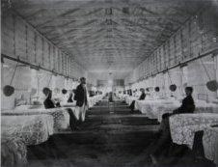
Under 1913 Mental Deficiency Act
150,000 Idiots, Imbeciles, Feeble Minded and Moral Defectives incarcerated for whole of their lives in long stay hospitals.
A Textbook of Mental Deficiency, wrote in his eighth edition of his textbook, "on the Euthanasia of the 80,000 or so imbeciles in the country utterly helpless, repulsive in appearance and revolting in manners. Their existence is a perpetual source of sorrow and unhappiness to their parents, and those who live at home have a most disturbing influence upon other children and family life..In my opinion it would be an economical and humane procedure were their existence to be painlessly terminated" (quoted in Joanne Ryan, politics of mental handicap 1991, 106)
Out of Sight: The Experience of Disability, 1900-1950.
Stephen Humphries and Ch 4 films.
http://www.youtube.com/watch?gl=GB&hl=en-GB&v=pI2UNbd7lxY

Slide 5

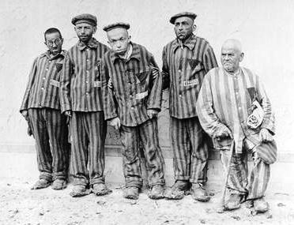
UKDHM Logo
Reclaiming our history
Inverting Nazi Symbol
Black Triangle
Compulsory Sterilisation 1933
Mass murder 1939 T4 Programme -250,000-1m

Slide 6

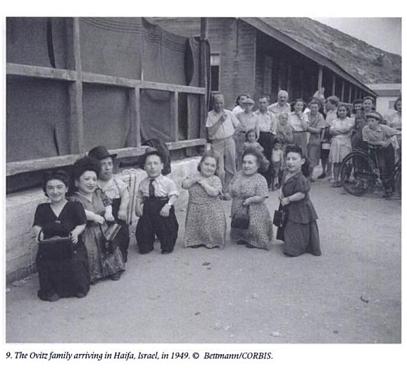
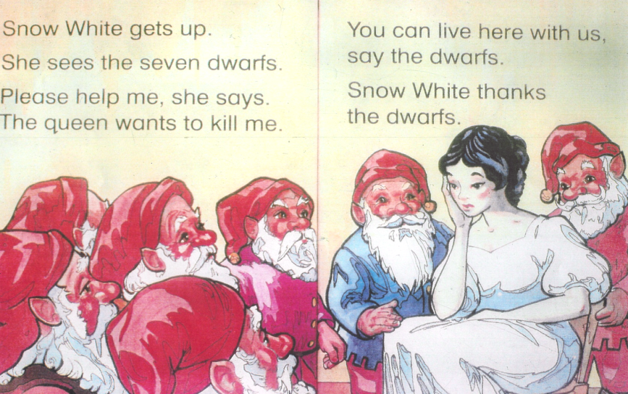
The story of the real ‘7 Dwarves’ or little people
The Ovitz family were a family of Romanian- born Jewish circus actors/travelling musicians who survived imprisonment at the at Auschwitz concentration camp and experiments on them by Josef Mengele. They went to live in Israel and carried on with their performances. However their health was badly effected by the treatment they received.
Throughout their lives they stuck together with their non-disabled siblings and refused to take part in freak shows considering themselves professional actors, musicians and singers
See Yehuda Koren, Eilat Negev, In Our Hearts We Were Giants - the Remarkable story of the Lilliput Troupe, 2004

Slide 7

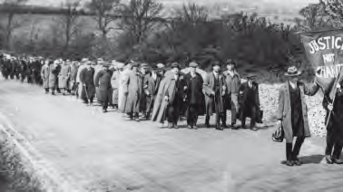
1920 March NLB
The National League of the Blind became the first formal disabled people’s organisation campaigning for employment and inclusive education. Doctors increasingly claimed the lives of disabled people as the ‘medical model’ dominated. We were categorised by our impairments. Veterans returning from war and blind workers rejected this labelling, which led to poverty. They fought for the right to work in the 1920s and 1930s
Access to Work support budget £120 million
With 3.4 million disabled people in work

Slide 8
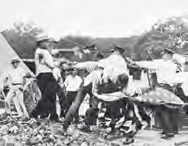
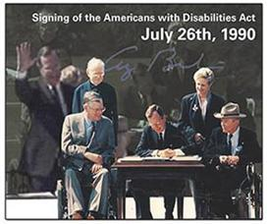
Washington 1932, USA
“The impatient
armies of the poor”
20,000 unemployed disabled
war veterans and their families
march on Washington. Tear gas
and bayonets are used against
peaceful protestors and 100
people killed. The events of
1932 inspire a new militancy
in the USA and the roots of
the disability rights struggle in
America.

Slide 9
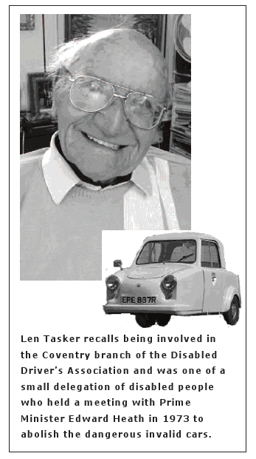
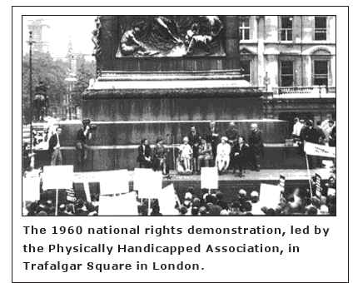
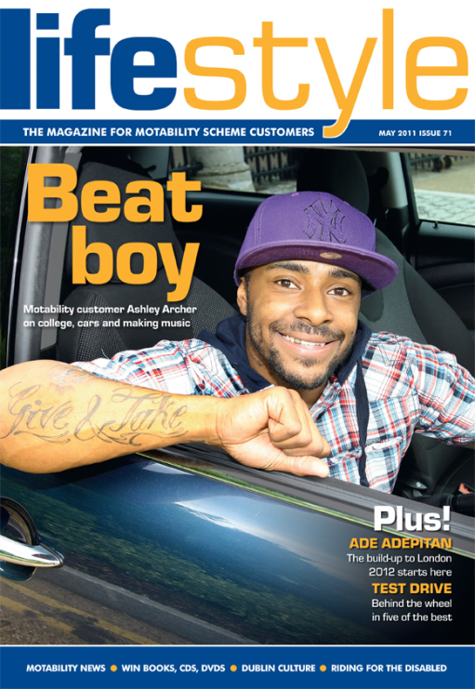
Stirrings of a new force
Motability is the largest hire fleet in
Europe – paid by Disability Living Allowance

Slide 10
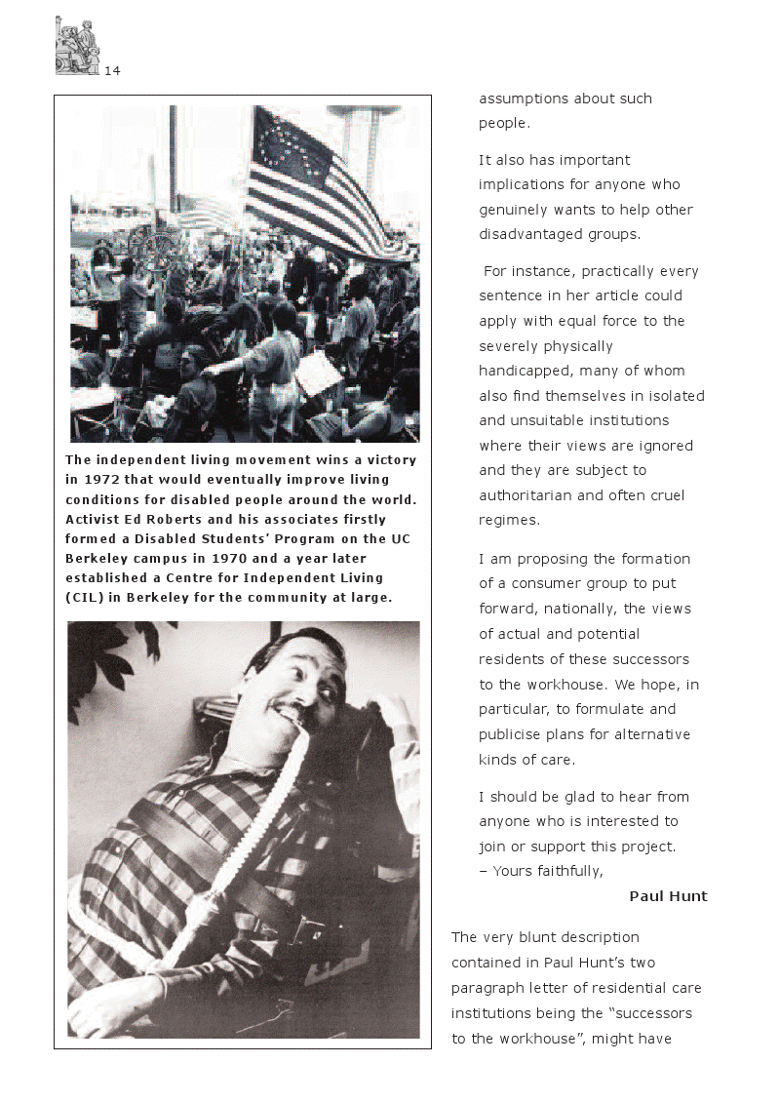
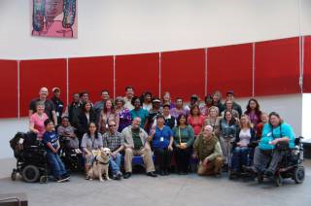
Independent Living Centres

Slide 11
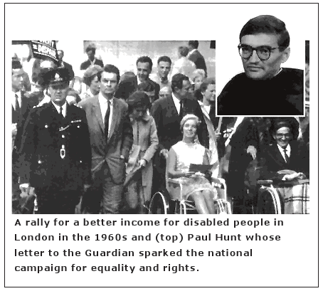
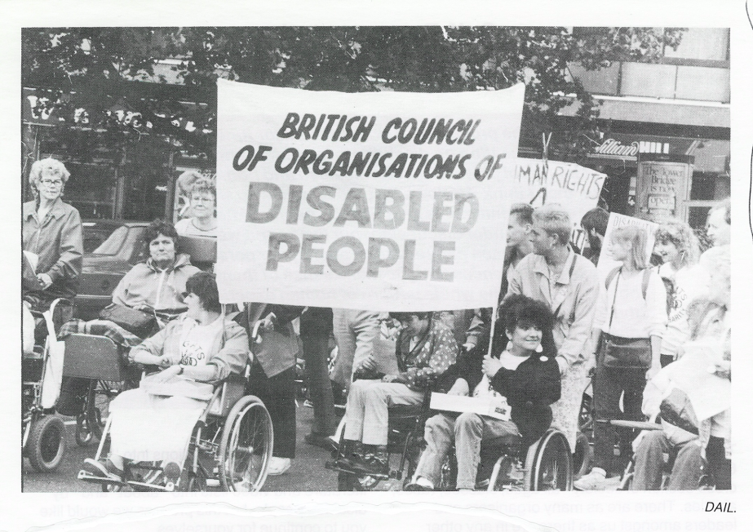
Paul Hunt writes to Guardian September 20th 1972
From this the Union of the Physically Impaired Against Segregation is Formed UPIAS &
The Social Model is invented
Disability Living Allowance is agreed by Conservative Government under Mrs Thatcher
This is to cover the extra cost of living as a disabled person
Estimated at 40% extra by OPCS
All DLA claimants will be re-assed for
Personal Independence Allowance
Want a reduction 20%

Slide 12
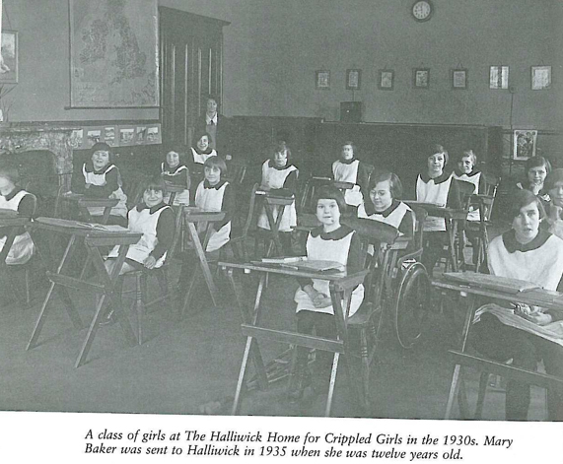
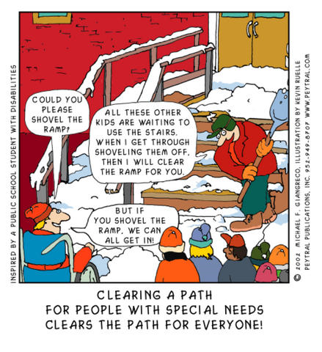
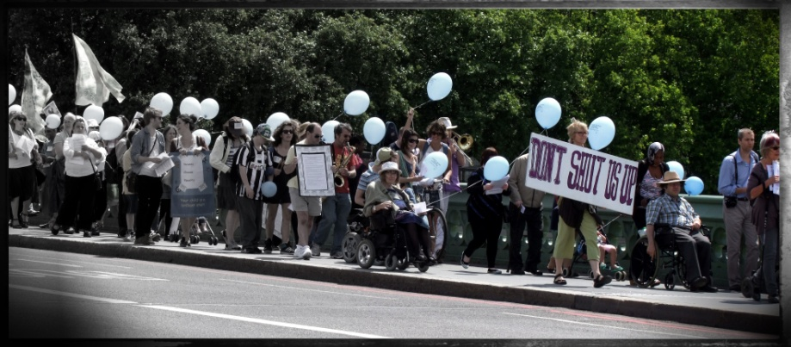
Education: The right to inclusion1981 to 2011
Inclusive Education is the practice of welcoming, valuing, empowering and supporting diverse academic and social learning among students in the same class. Inclusion can provide academic and social benefits for all students: both those who have special needs as well as typical students. Friendships develop, non-disabled students are more appreciative of differences and disabled students are more motivated.
Reverse the bias to segregation!
‘Remove the Bias to Inclusive Education’
Con Dem Government Policy

Slide 13
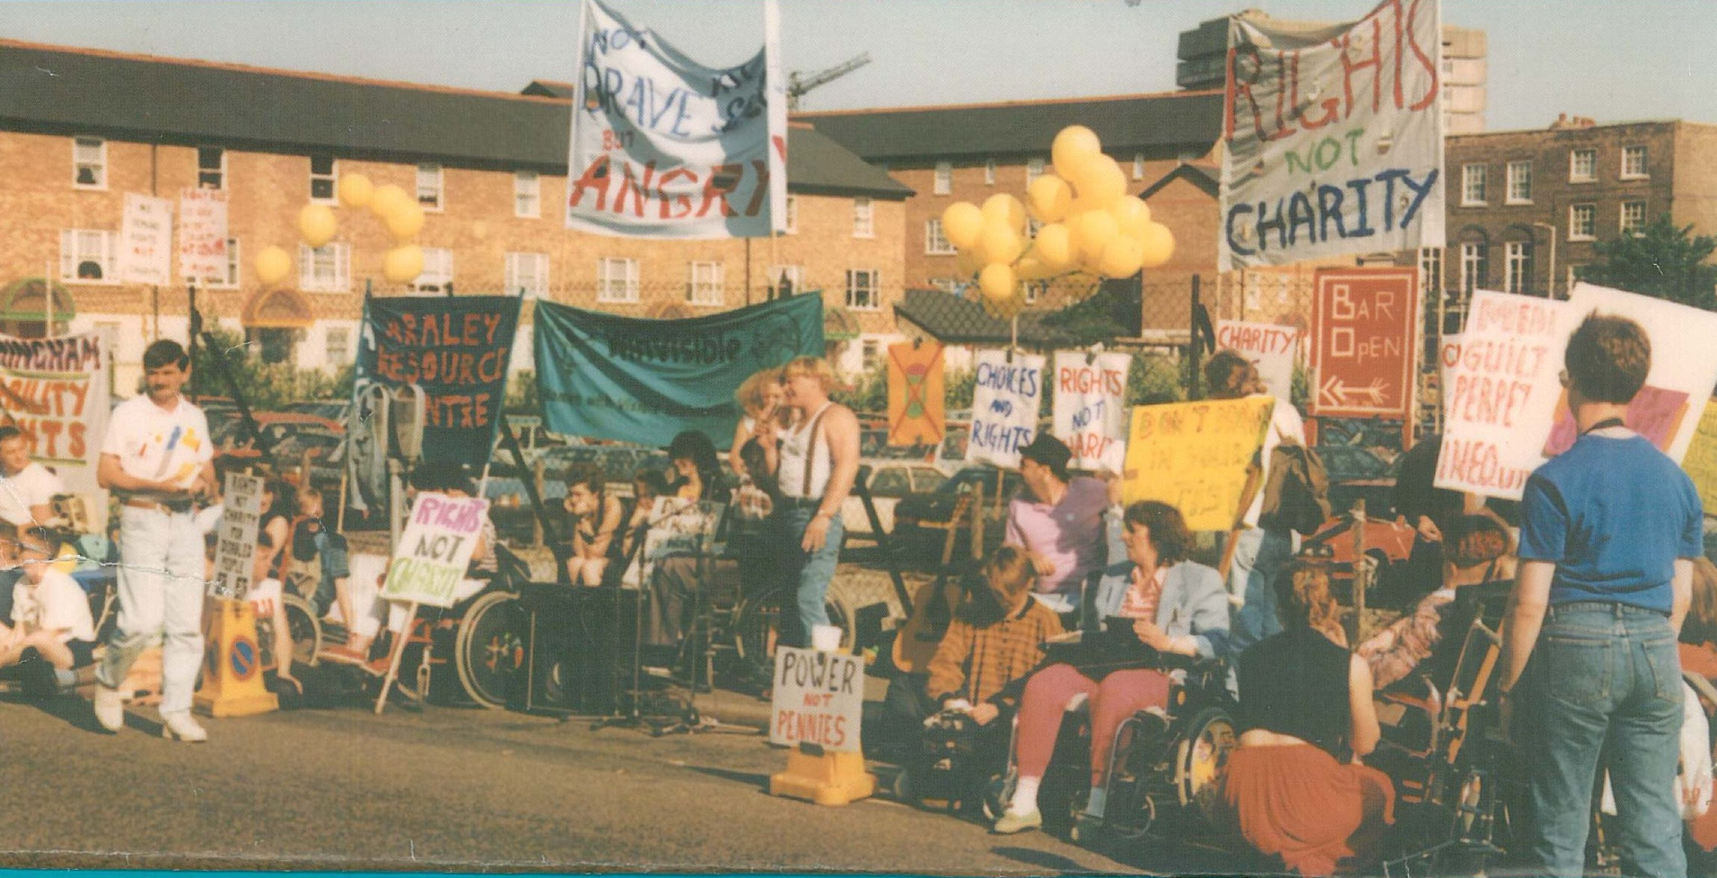
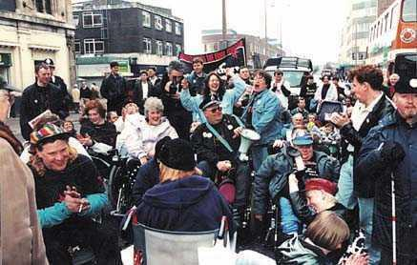

Telethon was
withdrawn
1991 Block Telethon- Nothing About Us Without Us
62% of buses are accessible all in London

Slide 14

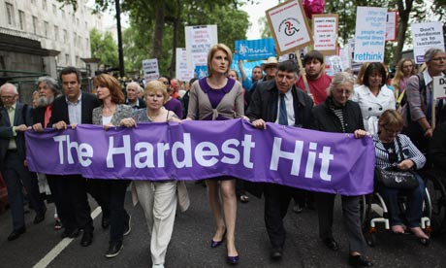
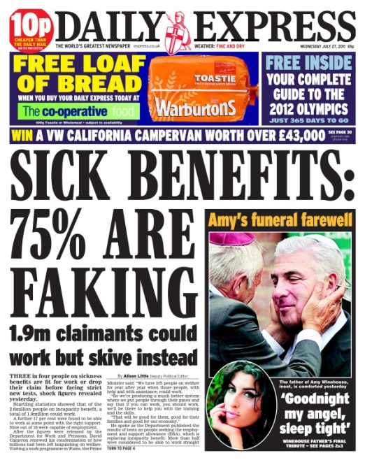
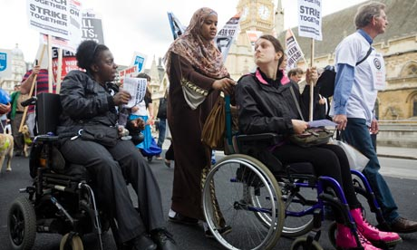

ATOS contract £300m to get 1.5 million of Incapacity Benefit through
Work Capability Test and onto Employment Support Allowance.

Slide 15
Challenge Stereotypes in the Media
Pitiable/Pathetic
A Burden-a drain on resources
Evil/Bad/Sinister
Atmosphere
A Joke/Laughable
Asexual
Aggressive Avenger/Chip on shoulder
Incapable adult responsibility
Mendacious/Fakers
Need to be fixed and made normal
Supercrip /TOT
1. Avoid depicting disabled people as always receiving. Show us as equals giving as well as receiving.
2. Avoid presenting physical and mental characteristics as determining personality
3.Refrain from depicting disabled people as objects of curiosity. Make us ordinary.
4. Impairments should not be ridiculed or made the butt of jokes.
5. Avoid sensationalizing disabled people especially as victims or perpetrators of violence.
6. Refrain from endowing disabled people with super-human attributes.
7. Avoid Pollyanna-type plots that make disabled people’s attitude the problem.
8. Show the social barriers disabled people face that keep us from living full lives.
9. Avoid showing disabled people as non-sexual. Show us in loving relationships and expressing the same range of sexual needs and desires as non-disabled people
10. Most importantly, train and employ disabled people, include us in scripts, novels, programmes, images, lectures publications and curriculum. Show us as a part of ordinary life.

Slide 16
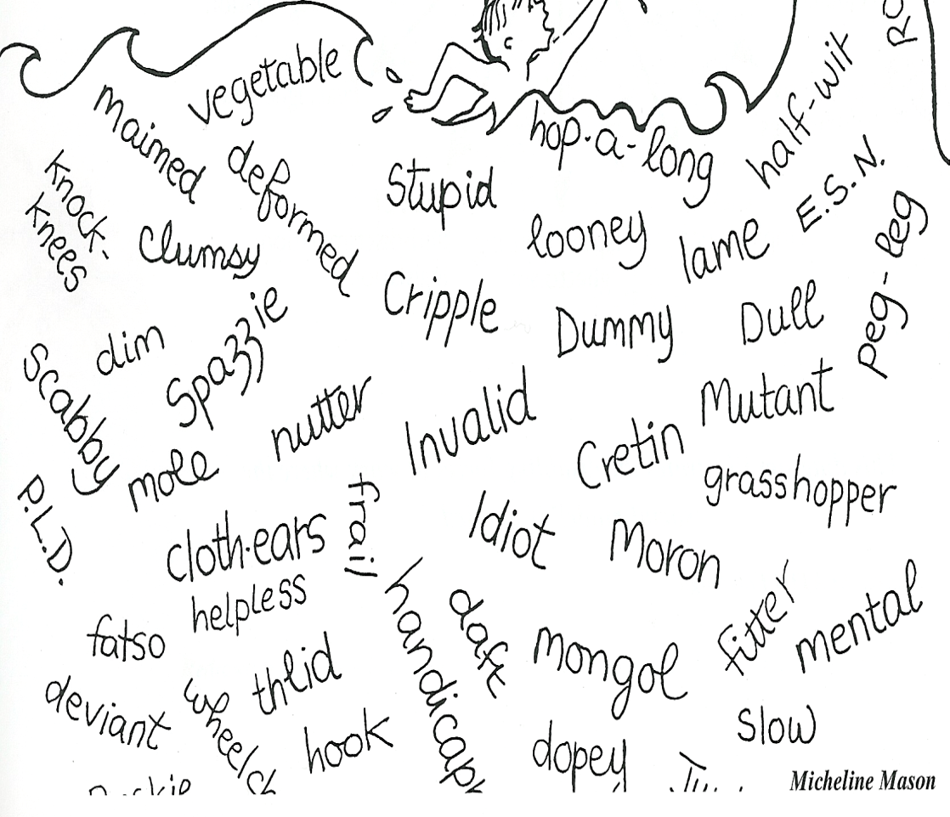
Labelling and Language
Don’t describe people by their impairment!
Only use impairment in technical reports!
We are disabled people –disabled by Society!
Avoid ‘sufferer’ or ‘victim of’!
We have a condition!
Educate your students!
http://www.worldofinclusion.com/res/qca/Language.doc

Slide 17
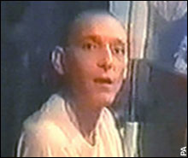
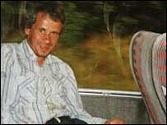
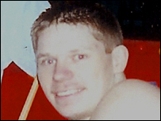
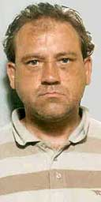
Hate Crimes against disabled people are more common than you think! UKDPC found 69 Murders and 520 serious attacks motivated by disability hate crime from Jan 2007 to July 2010!
Craig Robbins had learning difficulty and was viciously attacked leading to brain damage by three people- Wales
Kevin Davies who had epilepsy was kept in a shed for four months until he died/
Wigan
Rikki Judkins with Learning Difficulties beaten to death by two teenagers when visiting Lancaster
Raymond Atherton a man with learning difficulties repeatedly attacked and eventually killed by 2 teenagers after months of torture . Warrington

Slide 18
Scapegoating: Where does it come from?
Othering- process –Adorno, Social Psychologist
Unwanted comments and name calling
Jokes at disabled persons expense
Exclude from social group
Discriminate
Violence
Death
All is run by projecting onto others your own worries and insecurities
Increases at times of economic and social dislocation.

Slide 19
In the Social Model It's the barriers that disable !
Negative
Attitudes
Inaccesible
Environments
Bullying
Use of Resources
Poor Peer Support
Inflexible Curriculum
Lack of Communication
Lack of Role Models
Ignorance
Poor Teaching
Fear
Low Expectations

Slide 20
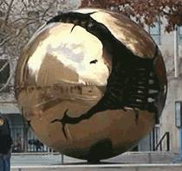

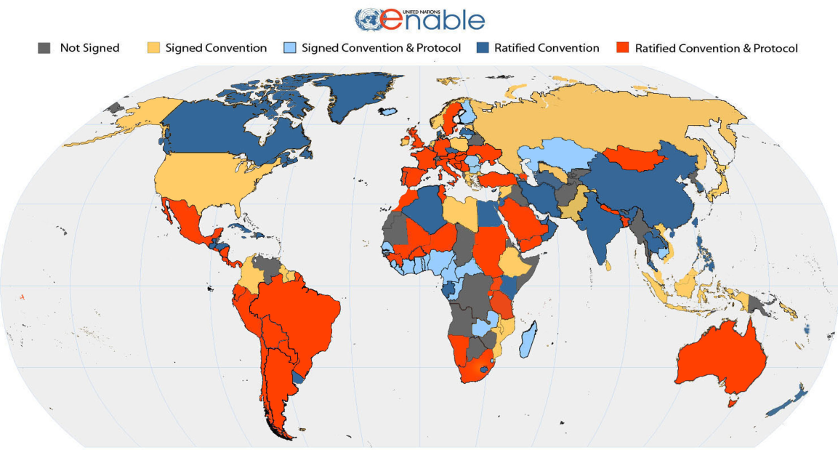
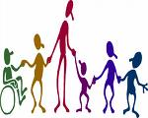
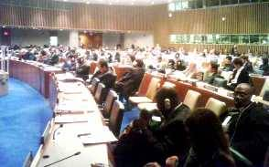
UNITED NATIONS CONVENTION ON THE RIGHTS OF PEOPLE WITH DISABILITIES DEC. 2006:A NEW PARADIGM CENTERED ON THE PERSON WITH DISABILITY
From Medical Model of Disability → Problem in the Person.
Cure, Fix or Separate
To Social Model of Disability based on Human Rights approach- Problem with Society that needs to be changed.
Attitudes
Organisation
Environment
To
154 signatories to the Convention
105 ratifications of the Convention

