Slide 1
English HE – an overview
6 February 2016
Andrew McGettigan
andrewjmcgettigan@gmail.com
@amcgettigan

Slide 2
Overview
Privatisation
Changes to Student Support
Loans
Financialisation
University Finances – Debt
Conclusion

Slide 3
privatisation
An articulated concept

Slide 4
1. Marketisation or external privatisation –
new operations with different corporate forms are allowed to enter the system to increase competition dissolving the distinction between separate public and private sectors.
But also – establishment of new market conditions.
Uncapping of sector and institutions for undergraduate recruitment.
2. Commodification – the presentation of higher education as solely a private benefit to the individual consumer; even as a quasi-financial asset where the return on investment is seen in higher future earnings.
3. Independence from regulation – also regulation as means to break up ‘public sector monopoly’.
4. Internal privatisation –changes to revenue streams within institutions so that for example, direct public funding is replaced by private tuition fee income.
We could add to this list:
5. The outsourcing of jobs and activities to the private sector and management consultants, which has become widespread in England.
6. Changes to the corporate form and governance structures of universities.
7. The entry of private capital and investment into the sector through buyout and joint ventures.
Complexity – cannot be left to journalists to unpick it.

Slide 5
Changes to student support

Slide 6
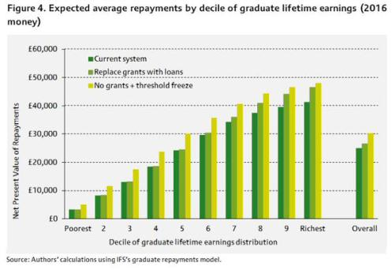

Slide 7
‘Consensus’ on fee-loan regime for full-time study
Maintenance support is adequate (or parents & family contribute to make up shortfall?)
  Rents in London
  Students also take out commercial debt with more onerous repayment terms
    Overdrafts, bank loans, credit cards, payday loans ...
    More onerous repayment terms
  And take on excessive paid work in term time
Graduate disposable income can support loan repayments without being burdensome
  Concurrency of PG loan repayment (15% above £21 000 threshold)
SLC Scheme is fair and progressive
  But regular reviews of terms now promised that can retrospectively increase payments
  Freezing threshold takes more repayments from lower and middle earners

Slide 8
loans

Slide 9
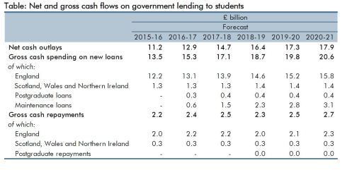

Slide 10
 | 2015/16 | 2016/17 | 2017/18 | 2018/19 | 2019/20 | 2020/21
New loans issued (£ billion) | 13.3 | 15.4 | 17.6 | 19.8 | 21.5 | 22.9
Repayments (£ billion) | 2.2 | 2.6 | 2.8 | 2.9 | 2.8 | 3.3
'Shortfall' - contribution to PSNCR (£ billion) | 11.2 | 12.8 | 14.8 | 16.9 | 18.7 | 19.6
Projected loan outlay & repayments - ENGLAND - cashflow (£ billion)
OBR, Economical & Fiscal Outlook November 2015

Slide 11
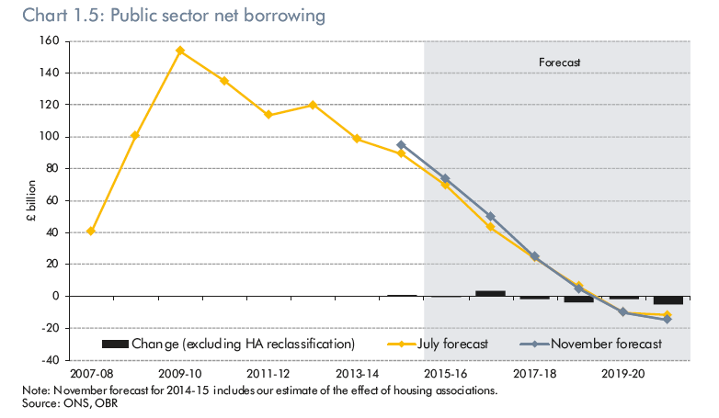

Slide 12
Financialisation
Putting Education into a system of accounts

Slide 13
Small Business, Enterprise and Employment Act
Royal Assent at the end of March 2015
Section 6 – ‘Evaluating Education’
‘[The measures] will also help to create an incentive and reward structure at universities by distinguishing the universities that are delivering the strongest enterprise ethos and labour market outcomes for their students.’
Conservative 2015 GE Manifesto:
  ‘require more data to be openly available to potential students so that they can make decisions informed by the career paths of past graduates’
Green Paper, November 2015
  “Section 78 of the Small Business, Enterprise and Employment Act 2015 now enables higher education data to be linked [and published] with HMRC income and employment data, and DWP benefits data to inform understanding of the labour market outcomes of graduates.” (fn. 22, p. 31)

Slide 14
Initial TEF metrics
“After informal discussions with the sector, we believe at present there are three common metrics (suitably benchmarked) that would best inform TEF judgements. We propose initially to base the common metrics on existing data collections:
Employment/destination – from the Destination of Leavers from Higher Education Surveys (outcomes), and, from early 2017, make use of the results of the HMRC data match;
Retention/continuation – from the UK Performance Indicators which are published by Higher Education Statistics Agency (HESA) (outcomes);
Student satisfaction indicators – from the National Student Survey (teaching quality and learning environment).”
Green Paper, November 2015, Ch 3, paragraph 12

Slide 15
Announcement from HESA, Dec 2015
“... we are currently reviewing national requirements for information.
“Our aim is to replace the current Destination of Leavers from Higher Education (DLHE) survey, and the Longitudinal DLHE, in 2017.
“We aim to improve data quality and reduce the burden of collection, by linking to HMRC data made available under the Small Business, Enterprise and Employment Act. We will also utilise improved links back to our student data to enhance our understanding of the paths students take into and through study, and on to their next destination.”

Slide 16
David Willetts –
Performance Indicators
May 2012: “I expect that, in the future, as the data accrue, the policy debate will be about the RAB charge for individual institutions … the actual Exchequer risk from lending to students at specific universities.”
September 2012: “Imagine that in the future we discover that the RAB charge for a Bristol graduate was 10 per cent. Maybe some other university … we are only going to get 60 per cent back. Going beyond that it becomes an interesting question, to what extent you can incentivise universities to lower their own RAB charges.”

Slide 17
Estimating the Human Capital of Graduates, Nuffield Foundation / IFS
“If different degrees from different institutions result in very different levels of earnings for students with similar pre-university qualifications and from similar socio-economic backgrounds, then this might affect both student choice and policies designed to increase participation and improve social mobility.”
http://www.nuffieldfoundation.org/estimating-human-capital-graduates

Slide 18
F.E.E.R.
Future Earnings and Employment Record
  19 June 2014 publication by Lord Young Enterprise for All
Proposal to ‘publish and index future employment and earnings data in a simple and accessible format so that students can assess the full costs and likely benefits of specific courses at specific institutions.’
  10 years post-completion [This data exists]
“Publishing this information through league tables would also promote competition and improvement amongst educators in their response to raising academic standards and their relevance to work and business.”

Slide 19
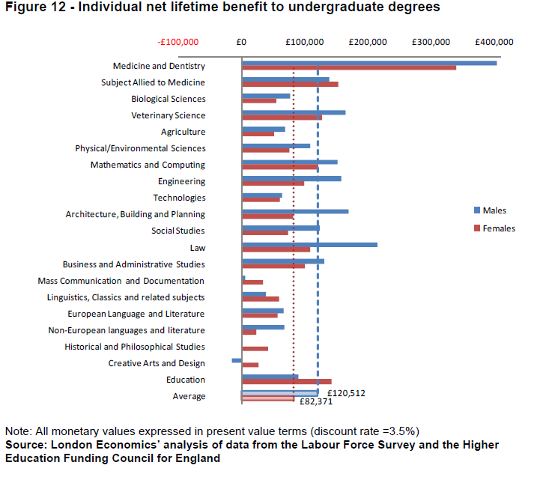

Slide 20
Creditworthiness of individuals & institutions
Milton Friedman: ‘the [repayment demanded] should in principle vary from individual to individual in accordance with any differences in expected earning capacity that can be predicted in advance--the problem is similar to that of varying life insurance premia among groups that have different life expectancy.’
‘The Role of Government in Education’
That is, ‘How much should this applicant from this district of this city with these qualifications be lent to do this course at this institution?’
  What are they likely to repay?
  Good university - one that produces graduates able to repay more (and pay higher income tax)
  Graduate borrower is bearer of unit of account(ing)

Slide 21
University finances - Debt

Slide 22


Slide 23
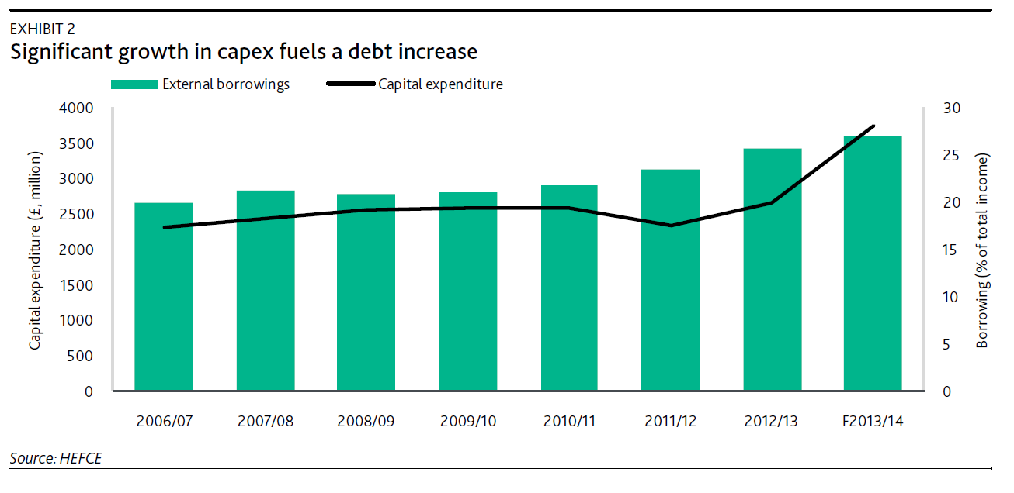
Moody’s, HE Sector Analysis April 2014

Slide 26
Conclusion /discussion points
TEF bureaucracy /workload vs ready-to-hand metrics
  Requiring data to be published /// using it in TEF to determine max fee
  Hard to argue that students shouldn’t see earnings data of course graduates
  Higher fees unlikely without evidence of ‘behavioural’ changes
    Institutional – marking to cost-base
    Graduates – less inactivity, more earnings in first 10 years of graduation
    Higher repayments – creditworthiness
Earnings data – management paroxysms
Sector Debt – a long-term challenge brewing?
Militant Research
  reading accounts,
  Freedom of Information requests,
  cataloguing the industry and business press for deals, financing and off-balance sheet activity, and so on.
  getting the truth out vs op-ed moralising
Alternative models
  Part-time, lifelong, civic tertiary education
  Versus ‘boarding school’ model – 3 years away from home for 18 year-olds

