Slide 1
‘What is FE For?’ FE Area Reviews and the future of FE
Dr Rob Smith
CSPACE
6th February 2016

Slide 2
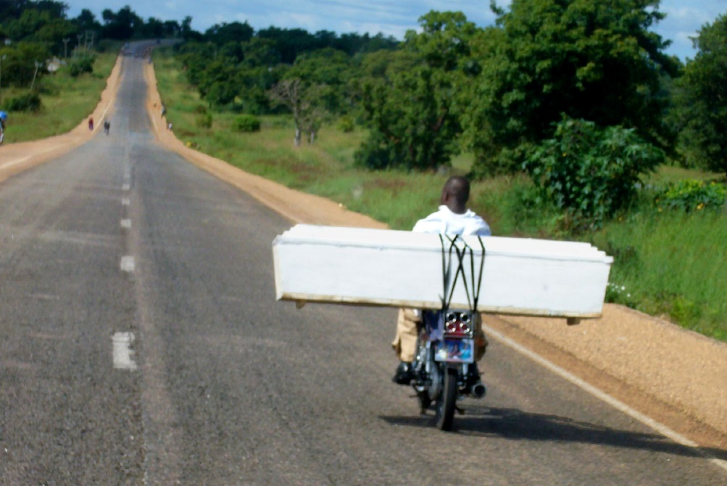
The End of an Era
Incorporation is dead.
Long live Area Reviews.
Holly Pierce: Coffin on a motorcycle, CC, no mods.

Slide 3
How did we get here?
Incorporation
The instrumentalisation of FE
Current Policy
The Dual Mandate
New Apprenticeships

Slide 4
FE:
Further as in more,
as in additional.
FE as
The Equaliser.

Slide 5
FE budget cuts
25-35%+ since 2009
As compared to HE rise in income (25%?)
And ring-fencing (of a kind) for schools.

Slide 6
Area Reviews
Collaboration
Merger
Productivity and efficiency gains.
Impact on social inclusion

Slide 7
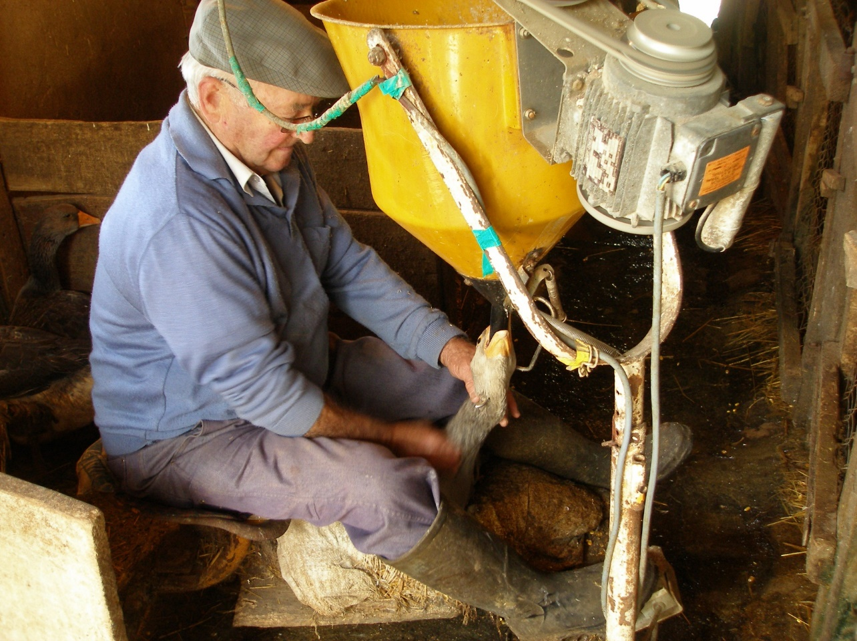
Linking funding and achievement in an annual cycle
Foie gras gavage in Rocamadour, France by Jerome. CC. no mods
Force-feeding for assessment

Slide 8
Overview: the impact of marketisation
“Breaking and building in the progression of this world go hand in hand.” (Fry)

Slide 9
Looking Ahead
Purposes: How can we re-establish broader FE purposes than the narrow instrumentalist ones that seem to dominate? & within that, how do we safeguard the interests of local communities that colleges are there to provide for?
FE teachers’ Professional identity & values: How do we ensure that key professional values of FE teachers are safeguarded in the current hostile policy environment?
Leadership: How do we reshape FE leadership to represent broader (local) educational interests and trumpet these to govt?
Funding & accountability: How do we ensure an emphasis on education rather than just qualification and achieve a funding regime that reflects this?

